Slide 1
Comprehensive Sales and Returns Analysis using SQL – A Case Study on Superstore

Slide 2


Overall Sales & Returns Overview:

Slide 3



Slide 4



Slide 5



Slide 6



Slide 7



Slide 8



Slide 9

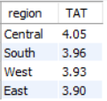
Regional Performance:

Slide 10
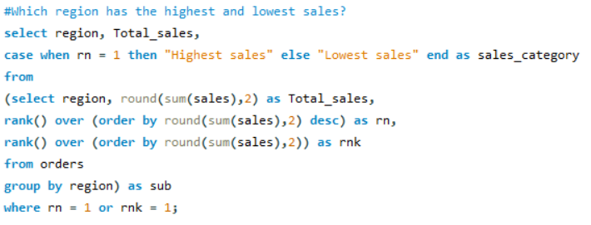


Slide 11
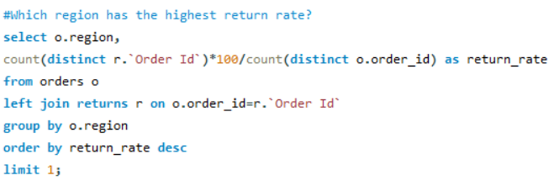


Slide 12

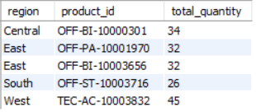

Slide 13

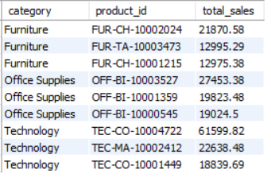
Category & Sub-Category Trends:

Slide 14



Slide 15



Slide 16



Slide 17


Profitability & Discounts:

Slide 18

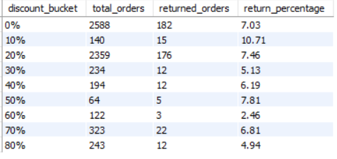
There is no strong or consistent correlation that higher discounts lead to more returns in this dataset. In fact, mid-level discounts like 10%-20% seem to have slightly higher return rates, but deep discounts (60%-80%) show lower return rates, possibly due to customer expectations being met at those price points.

Slide 19

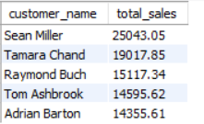
Customer Behaviour:

Slide 20

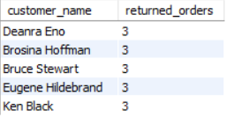

Slide 21

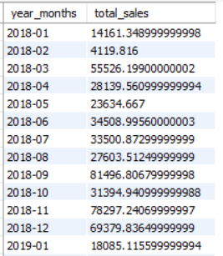
Time-Based Insights:
*48 rows returned

Slide 22

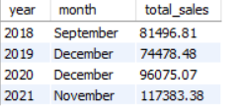

Slide 23

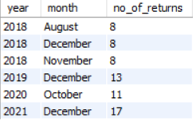

Slide 24

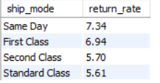
Shipping & Return Patterns:
Based on the return rate differences, yes — shipping mode influences return behaviour. Customers using faster delivery services (especially Same Day) tend to return more orders. Standard Class (typically cheapest/slowest) has the lowest return rate at 5.61%.

Slide 25


Detecting Outliers:
*240 rows returned

